Slide 1
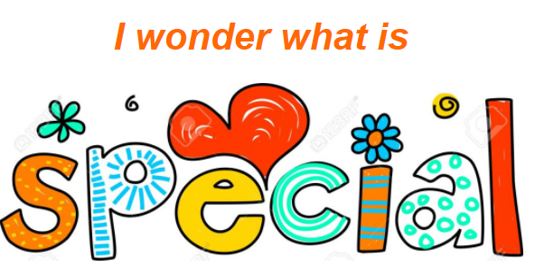
Personal, Social & Emotional Development
Talk about our likes and dislikes.
Talk about our families, friends, people who are important to us. How do they make us feel?
What is our favourite toy? Food? Outing?
What makes us laugh? Cry?
Who do we love?
Talk about other people we know, others in the setting.
What do we have in common with them, what is different about us?
Talk about how I can be kind.
Talk about different feelings.
Literacy
BOOKS: All about me board books, Funny bones, Rosie’s Walk, Only One You, Titch, Super Duper You.
Ask the children to find their favourite books to bring in and share with everyone.
Use plastic letters draw around and make templates for our names and names of family and friends. Then use the letters to match the drawn spaces like a puzzle.
Do letter rubbings and then cut out each letter and stick them on a piece of coloured paper to spell our names.
Make a topic book all about them selves, like, dislike, eye colour, hair colour etc.
Mathematics
Once you have used the letters to make o the names of loved ones and themselves, organise the names into groups according to the numbers of letters in them.
Draw around our hands and feet, cut them out and compare and organise them into size order.
Sing songs like ‘I have 10 little fingers’ and ‘1finger, 1 thumb keep moving’
Understanding The World
Make a house with doors and windows that open and fill them with photos of family and friends.
Reflect on the features of my home.
Talk about how life has changed.
Make a puzzle of ourselves by printing a photo of ourselves onto card and cutting in in to pieces to meet each child’s ability to complete puzzle.
Cut up magazine pictures of people and make a new person by gluing bits on a picture.
Look at pictures of people from other parts of the world, what they look like, what are their houses like? Do they have pets? What do they wear? What do they eat? What toys do they have? What languages do they speak?
Talk about important places in our local community.
Communication and Language
NEW LANGUAGE: like, dislike, family, friends, belonging, home, myself.
Sing songs about ourselves, our feelings and our bodies. Head, shoulders, knees and toes. If your happy and you know it (change some words to include feeling and expression such as ‘if your tired and you know it, give a yawn’)
Read stories about people, jobs they do, hobbies, emotions, families.
Talk about people from other countries and how their lives are different or similar to ours.
All About Me
Expressive Arts and Design
Make a house with doors and windows that open and fill them with photos of family and friends.
Make a model of their house using construction materials.
Make a puzzle of ourselves by printing a photo of ourselves onto card and cutting it into pieces to meet each child’s ability to complete a puzzle.
Cut up magazine pictures of people and make a new person by gluing bits on a picture.
Make a face in nature using natural materials from the outdoor environment.
Act out and represent different feelings using The Colour Monster.
Create a picture with key features of my appearance and talk about the difference between my appearance and others.
Physical Development
Use our senses. Set up taste session while blindfolded. Sit quietly and listen, see what you can hear. Enjoy some sensory play. Set up some sniff and match toys with different natural oils, lavender in a bag etc.
Paint the inside of an egg box different colours, one colour in each dip and then go on a colour hunt and collect something to go in each section.
Can I….hop? Jump? Crawl? Roll? Catch a ball?
Sing ‘Head, shoulders, knees and toes’ and do the actions.
Name parts of the body.

