Slide 1
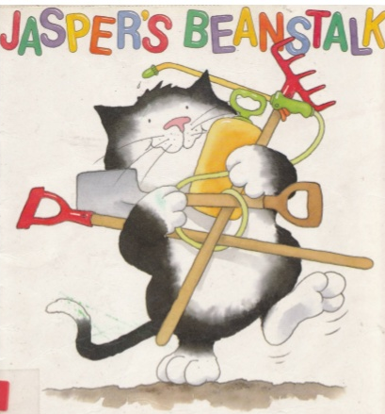
Reception Class
Summer Term
Literacy
Sequence the story using the cards.
Model writing letters to Jasper to try and find out what is at the top of beanstalk.
Children to complete bean diaries.
Write name labels for their beans.
Jaspers beanstalk story sack and words in the writing area.
Mark making in soil for the children who need it to make marks.
Use non-fiction books to find answers to our questions
Make a class non-fiction book
Instructional Writing
Recount Writing
My favourite memory of Reception
Group Reading
Phonics – Phase 3
Communication & Language
Jaspers beanstalk story sack.
Explore different stories around this theme such as – jack and the beanstalk, titch, monkey puzzle.
Personal, Social & Emotional
Development
Talk about how Jasper felt at different parts of the story e.g. happy, excited, bored.
Circle time pass the bean around the circle what would the children like to find at the top of jaspers beanstalk.
Transition to year 1
Discuss how they could help next year’s Reception class.
Mathematics
Beginning to use mathematical names for ‘solid’ 3D shapes and mathematical terms to describe shapes.
Selects a particular named shape.
Use familiar objects and common shapes to create and recreate patterns and build models.
Uses everyday language related to time.
Orders and sequences familiar events.
Measures short periods of time in simple ways.
Can describe their relative position such as ‘behind’ or ‘next to’.
Measuring different beanstalks using language of taller, shorter.
Bean addition use the cards with numerals on and ask the children to place the correct number of beans onto each one.
Days of the week activity ordering and talking about time and how it passes in the story.
Beanstalk height chart in the home corner so children can measure each other and use the language they have learnt.
Challenge the children to try and work out how many beans they can place inside a container, can they estimate and then count.
Physical Development
Collecting snails fine motor activity.
Bean game.
Children to pretend to climb the beanstalk, pick up snails and dig up the bean.
Talk about different vegetables and healthy foods – try different beans.
Healthy eating
Pencil control: Letter formation and letter clusters
Sports day practise
Safety in the sun
PE FOCUS: Games
Understanding the World
Look and talk about the life cycle of a bean.
Children to plant and observe their own beans.
Plant different plants and bulbs outside.
Use different colour water and white flowers to observe how the after feeds the stems and they change colour.
Children to draw beanstalks of different heights around the nursery.
Planting area set up inside and outside.
Children to use magnifying glasses while observing living things.
Computing: Junior Explorers - Children will learn to give sequences of instructions to control Bee-Bots (floor robot). Children will understand that instructions need to be given in a correct order.
Science: Plants - Looks closely at similarities, differences.
-Can talk about some of the things they have observed such as plants, animals, natural and found objects.
-Shows care and concern for living things and the environment.
RE: Values and commitments - Friendship
What is a friend?
Why were Jesus’ friends special to him?
Am I a good friend?
Expressive Arts & Design
The children to paint pictures of what they would like to see at the top of the beanstalk.
Children to use musical instruments to make sounds to accompany the story.
Observational drawing of the beans.
Materials in the construction area so the children can build their own beanstalks.
Role play garden centre.
Making flowers to sell in Garden Centre Role Play
Making seed packets
Music – Our World – explores animals, jungles, mini beasts, night and day, sand and water, seaside, seasons, weather, sea, space.
Art & DT – 3D work

